Slide 1
CS44/55: Data Science and Applied Machine Learning
Class Lecture: February 8th, 2023

Slide 2
Objectives
Last time:
.filter(), .apply() & Lambda functions
.loc/.iloc methods
Today:
Uploading datasets to Colab
Statistics using Python
Standard Deviation

Slide 3
Dropping Columns & Rows
There are going to be times where you will need to remove columns or rows from your dataset
The .drop() method makes this easy, as you only have to choose the column/row name(s) (or number)
However, it is important to note that you must specify the axis when you use .drop
axis=0 will look to drop a row (default)
axis =1 will look to drop a column
Ex: df.drop([‘col_1_name’, ‘col_2_name’], axis=1)
Ex: df.drop([row_num_1, row_num_2])

Slide 4
Common Pandas Methods
This list of common methods should help you throughout the class:
mean() Returns the average value over requested axis
.mode() Returns the mode over requested axis
.std() Returns Standard Deviation over requested axis
.sum() Returns sum of values over requested axis
.max() Returns max value of requested axis
.min() Returns minimum value over requested axis
.idmax() Returns index of first occurrence of maximum over requested axis.
.idmin() Returns index of first occurrence of minimum over request axis

Slide 5
Common Pandas Methods
This list of common methods should help you throughout the class:
.unique () Return unique values based on a hash table
.nunique() Counts the number of distinct elements in specified axis.
.count() Count non-NA cells for each column or row.
.value_counts() Returns a pandas series containing counts of unique values.
.sorted_values() Sort by the values along either axis.
.astype() Cast a pandas object to a specified dtype
.dtypes() Return the dtypes in the DataFrame

Slide 6
Statistics Vs. Data Science
It is very common for data science and mathematical statistics to be used interchangeably
To be fair there are a number of similarities between the two concepts
Does anyone have any thoughts on the difference?

Slide 7
Statistics Vs. Data Science
The most common distinction between data science and statistics is that statistics is purely mathematical field
Statistical analysis usually has the following traits:
Uses smaller data samples,
Only makes use of quantitative data
Statistics usually involves a more formal approach to experimenting:
Proving of disproving a hypothesis
Making and noting assumptions
More consideration for where our data comes from

Slide 8
Statistics Vs. Data Science
Data science is an interdisciplinary field involving Computer Science, Information Technology and Statistics
Data science is most commonly associated with:
Making predictions
Comparing models to find the simplest approach
Working with large quantities of data (in some extreme cases trillions of parameters)
That said today the two fields are closely related, especially with the concept of machine learning

Slide 9
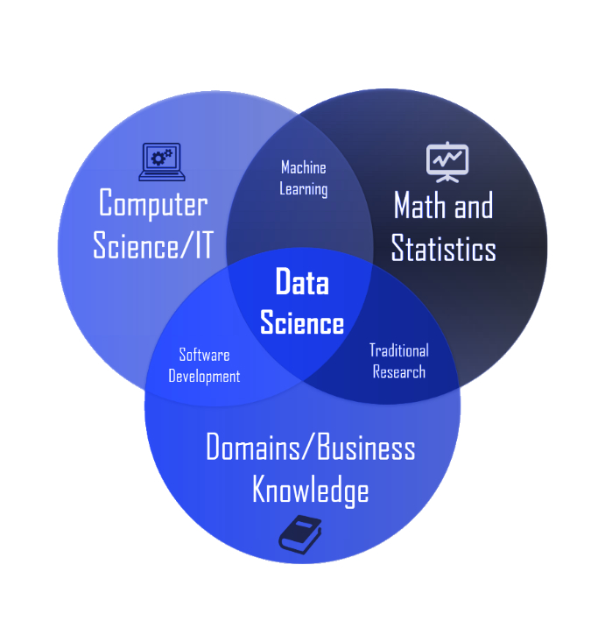
Statistics Vs. Data Science
Source: Is Data Science Just a Rebranding of Statistics?

Slide 10
Probability
Most statistics textbooks define probability as the “likelihood of an event occurring”
In machine learning, many of the common models rely on some sort of probability
Some examples includes:
Tree based models using Gini impurity
Naïve Bayes based models (conditional probability)
Logistic regression
Let’s take some time to review some basic concepts relating to probability

Slide 11
Probability Rules
Rule 1: The probability of an impossible event is zero; the probability of a certain event is one. Therefore, for any event A, the range of possible probabilities is: 0 ≤ P(A) ≤ 1
Rule 2: For S the sample space of all possibilities, P(S) = 1. That is the sum of all the probabilities for all possible events is equal to one.
Rule 3: For any event A, P(A^{c}) = 1 - P(A). It follows then that P(A) = 1 - P(A^{c})
Source: Penn State Eberly College of Science

Slide 12
Probability Rules
Rule 4 (Addition Rule): This is the probability that either one or both events occur:
If two events, say A and B, are mutually exclusive - that is A and B have no outcomes in common - then P(A or B) = P(A) + P(B)
If two events are NOT mutually exclusive, then P(A or B) = P(A) + P(B) - P(A and B)
Source: Penn State Eberly College of Science

Slide 13
Probability Rules
Rule 5 (Multiplication Rule): This is the probability that both events occur:
P(A and B) = P(A) • P(B|A) or P(B)*P(A|B) Note: this straight line symbol, |, does not mean divide! This symbols means "conditional" or "given". For instance P(A|B) means the probability that event A occurs given event B has occurred.
If A and B are independent - neither event influences or affects the probability that the other event occurs - then P(A and B) = P(A)*P(B). This particular rule extends to more than two independent events. For example, P(A and B and C) = P(A)*P(B)*P(C)
Source: Penn State Eberly College of Science

Slide 14
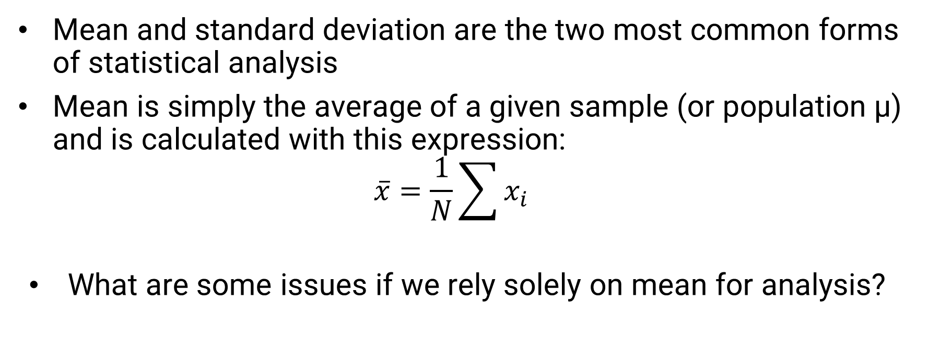
Mean and Standard Deviation
Mean and standard deviation are the two most common forms of statistical analysis
Mean is simply the average of a given sample (or population µ) and is calculated with this expression:
$$\overline{x}=\frac{1}{N}\sum{x_{i}}$$
What are some issues if we rely solely on mean for analysis?

Slide 15
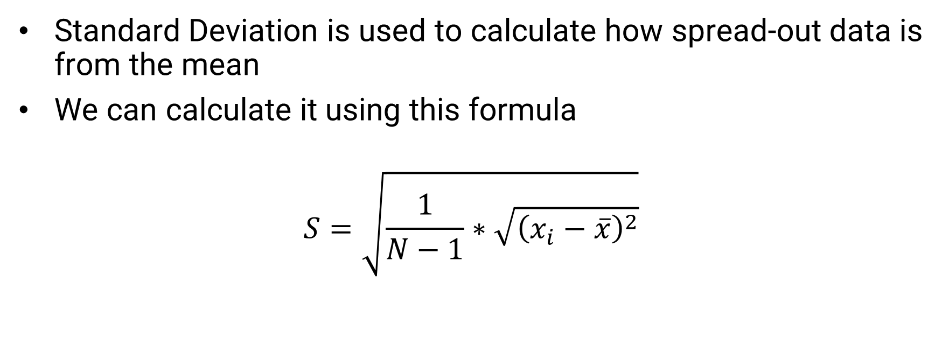
Mean and Standard Deviation
Standard Deviation is used to calculate how spread-out data is from the mean
We can calculate it using this formula
$$S=\sqrt{\frac{1}{N−1}∗\sqrt{{\left(x_{i}−\overline{x}\right)}^{2}}}$$

Slide 16
Mean and Standard Deviation
Assuming a Gaussian (Normal) distribution, with a mean of zero,
68.2% of the sample will lie inside one standard deviation,
95.4% will lie inside two standard deviations
99.8% will lie inside three standard deviations
The population standard deviation is denoted by σ.
Variance is simply the square of the standard deviation (σ²
Let’s do some practice with both probability and standard deviation using Colab

Slide 17
Next Time
Continue discussing statistics
Correlation
Hypothesis Testing & P-values
Possibly Linear Regression and SPC
Homework 3 is due before class on 2/15
Homework 4 will be assigned next week

